Slide 1
Module 3 NetApp Cloud Volumes ONTAP
1
Notes:
Instructor Notes
Student Notes

Slide 2
This module focuses on enabling you to do the following:
Deploy and configure OnCommand Cloud Manager from NetApp Cloud Central
Use Cloud Manager to deploy NetApp Cloud Volumes ONTAP software
Notes:
Instructor Notes
Student Notes

Slide 3


Enterprise Class Cloud Storage
Review
Cloud Storage
Cloud Volumes
Service for AWS
Cloud Volumes
ONTAP
Azure NetApp Files
Notes:
Instructor Notes
This slide indicates that we are focusing on Cloud Volumes ONTAP in this module.

Slide 4
Cloud Volumes ONTAP
Notes:
Instructor Notes
Student Notes

Slide 5



Cloud Volumes ONTAP
Advanced storage capabilities in the hyperscale cloud
Software-only storage system that runs on customers’ raw cloud storage
Point-and-click deployment of instances by using Cloud Manager
Instantaneous Snapshot copies
Zero-footprint clones with FlexClone volumes
Storage efficiency with data deduplication, thin provisioning, and compression
NFS, CIFS, and iSCSI
Replication capabilities (SnapMirror software and SnapVault software)
Notes:
Instructor Notes
Student Notes

Slide 6
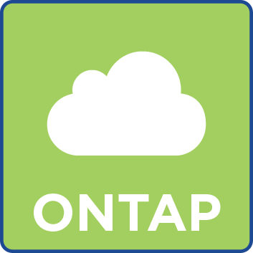
Cloud Volumes ONTAP Software
Use Cases and References
Data protection: data recovery and backup in the cloud
Production workloads
Lightning fast DevOps and application development and test
Enterprise-grade file shares

Slide 7

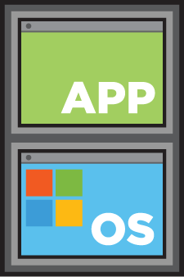

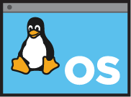
Cloud Volumes ONTAP Architecture
NFS
iSCSI
CIFS
CV ONTAP
EBS / LRS
Notes:
Instructor Notes
Cloud Volumes ONTAP supports cloud, multi-cloud, and hybrid architectures.
In a cloud architecture, the cloud provider offers [1] storage, compute, and [2] data tiering object storage. [3] Cloud Volumes ONTAP software runs as a virtual machine that uses the cloud-provided resources, [4] enabling the client application to access data over the CIFS, iSCSI, or NFS protocols.

Slide 8




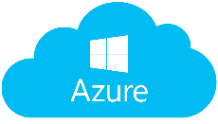
Cloud Volumes ONTAP Architecture – Disk Allocations
VPC
VM
....
....
Data Disks
Root disk
140GB GP2
Boot disk
42 GB PIOPS 1250
Data Disks
Root disk
140 GB
Boot disk
70 GB
Premium storage account
System Disks
System Disks
Availability Zone A
Subnet
Virtual Private Cloud
Virtual Network

Slide 9


Usage Example: Disaster Recovery
Using SnapMirror software to protect on-premises data in the cloud for disaster recovery
Cloud Manager
Data Center
NFS
iSCSI
CIFS
SnapMirror Software
EBS
Notes:
Instructor Notes We can use Cloud Volumes ONTAP for a disaster recovery scenario that we will implement in the labs in the next module.
Student Notes

Slide 10





Usage Example: Data Analytics
Using Cloud Sync service to migrate data to an object store for data analytics
EMR
HDInsight
Google
Analytics
Cloud Sync
Object storage
Cloud Volumes ONTAP
IBM Storage
GCP Storage
Azure Blob
AWS S3
Notes:
Instructor Notes Bring NFS/CIFS data in CVO to object storage using Cloud Sync for data analytics

Slide 11

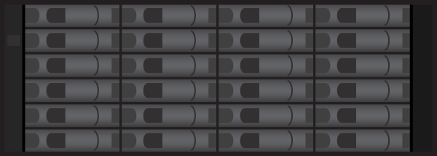
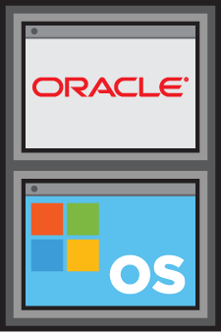
Usage Example: Development and Test
Build, test, and deploy on Cloud Volumes ONTAP software
Rapidly build out your test and development environment
Keep your persistent, production environment in your data center
Clone your environment in the cloud
Grow to NetApp Private Storage (NPS) or transition to the data center for production
Data Center
Cloud Manager
Copy A
Clone
Clone
Clone
Clone
SnapMirror Software
A
B
Copy B
Clone
Clone
Clone
Clone
Notes:
Instructor Notes This shows the major benefit of doing dev/ops using FlexClone.
Student Notes Use the public cloud for its “instant” provisioning capabilities.
Turn resources on and off as needed.
Take advantage of cost-effective industry-leading data management features such as FlexClone software and thin Snapshot copies.
Eliminate downtime that is spent waiting on resources.

Slide 12

Usage Example: File Shares in the Cloud
Replace or extend your on-premises NAS shares with cloud and grow as you go
Take advantage of the leading NAS capabilities of NetApp:
Storage efficiencies
Encryption
Snapshot copies
Protect against ransomware in the cloud
Notes:
Instructor Notes
Information on how a real customer quickly recovered from Ransomware using NetApp technologies:
The customer was hit with ransomware, and within about 30 minutes each and every one of it’s Windows machines (desktops/laptops/servers/AD/Exhange, everything) was impacted and their drives encrypted. The entire company (40K+ employees) came to a complete standstill. The *only* restore method that has saved them is in their virtualized environment, much of which was on NetApp. We ended up creating vol clones from the day before they were hit. Those clones were “hardened” by the Vmware team in a segregated network, then vmotioned back in to the corp network. Via vol clones/snapshots, they were able to get restored quickly and without taking up extra space on their storage.
Student Notes

Slide 13



Usage Example: Multiregion Application Coverage
Multiple Availability Zone (AZ) operation in EU West, data recovery in EU Central
AWS Availability Zone 1
AWS Availability Zone 2
NFS
iSCSI
CIFS
NFS
iSCSI
CIFS
AWS Region 2 (EU Central)
AWS
AWS
EBS
Replicate Data (SnapMirror Software)
EBS
EBS
AWS Region 1 (EU West)
EBS: Amazon Elastic Block Store
Notes:
Instructor Notes
We can have application data available across multiple Availability Zones using SnapMirror.
We can also use SnapMirror across multiple regions.
Student Notes

Slide 14
Deploying Cloud Volumes ONTAP by Using Cloud Manager

Slide 15

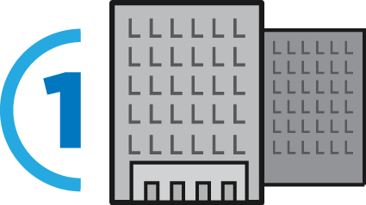
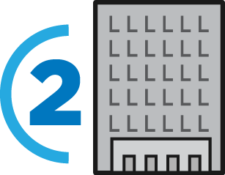

Provisioning for the Hybrid Cloud
On-Premises
Cloud
Storage
Administrator
Local deployment of hardware or software
Typically local network access
Typically shared storage
Remote deployment of software through a marketplace
Public and private network access
Typically dedicated storage
Primary
NPS
Cloud
Notes:
Instructor Notes
Student Notes
The data management requirement for on-premises storage system resources differs from the requirements of resources in the cloud. Cloud Manager was developed to create an easy and intuitive customer experience for both deploying Cloud Volumes ONTAP software and helping to provision NetApp Private Storage (NPS) resources.

Slide 16

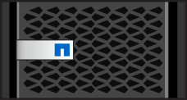

Cloud Manager
Features
Streamline the deployment, management, and tracking of cloud storage
Achieve enterprise-class management for hybrid cloud storage from on-premises to multiple cloud providers
Ease the movement of data across the Data Fabric with click-and-drag simplicity
Azure
AWS
Data Center
SnapMirror Software
EBS or LRS
Cloud Manager
Manage and monitor cloud storage on site or directly in the cloud.
LRS: Azure Locally Redundant Storage
Notes:
Instructor Notes
Student Notes
Cloud Manager is the deployment environment for Cloud Volumes ONTAP software. It offers a point-and-click installation and automatically selects and assigns resources to each instance. When you deploy Cloud Volumes ONTAP software, Cloud Manager uses your cloud credentials to select the compute and storage necessary to run the instance of your choice. With visibility into the actual resources that are consumed by each instance, Cloud Manager monitors and tracks cloud resource use. You can later use this information in assessing your environment.
Cloud Manager provides management for your ONTAP hybrid enterprise storage environment, including the Cloud Volumes ONTAP storage service and AFF and FAS systems. Cloud Manager brings together Data Fabric elements with a single management interface that is independent of the data location. This solution eases the day-to-day requirements of Cloud Volumes ONTAP storage in both Amazon Web Services (AWS) and Microsoft Azure, including configuring, provisioning, and monitoring each active virtual and hardware storage node.
ONTAP hybrid cloud environments store applications and data both on-premises and in the cloud. Cloud Manager eases the movement of data across the Data Fabric with click-and-drag simplicity to automate data movement between on-premises and the cloud. You simply identify the source volume, destination volume, and a replication policy and schedule. Cloud Manager configures the relationships, applies the replication policy, and then starts the initial transfer between the volumes.

Slide 17
Cloud Manager
More Features
Provides cloud resource cost monitoring
Provides central point of control for all cloud data
Manages data replication to and from the data center and the cloud
Eases license and entitlement management
Notes:
Instructor Notes
Student Notes

Slide 18


Cloud Manager
Deployment options
Cloud Manager in a Public Subnet
Cloud Manager in a Data Center
AWS
AWS
Region
Data Center
Region
VPC
VPC
Public Subnet
Cloud Manager
NAT Device
Cloud Manager
Private Subnet
Private Subnet
Router
VGW
Gateway
VPN
VGW
Router
NAT: Network address translation
Notes:
Instructor Notes
The Cloud Manager can also be deployed in the private subnet. That is what we are doing in the lab- deploy a cloud manager in the private subnet.
Cloud manager should have connectivity to the subnet where CVO is deployed.
Student Notes
Cloud Manager can be run from various locations, depending on the environment.
The left graphic shows Cloud Manager that is running in a public subnet and single-node Cloud Volumes ONTAP instances that are running in a private subnet. To deploy this method in an AWS environment, launch an instance from AWS Marketplace. Likewise, in an Azure environment, deploy a new virtual machine (VM) from the Azure Marketplace.
The right graphic shows Cloud Manager that is running in a data center and single-node Cloud Volumes ONTAP instances that are running in a private subnet. To deploy this method for either an AWS or Azure environment, download and install the software on an existing host or VM.

Slide 19
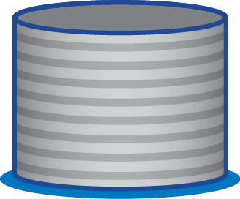

Cloud Manager
Deployment steps
Deploy Cloud Manager from Cloud Central.
Launch Cloud Manager.
Configure Cloud Manager.
Deploy Cloud Volumes ONTAP software by using Cloud Manager.
Volume
Cloud Manager
Aggregate
Amazon or Azure disks
Notes:
Instructor Notes
See YouTube video:
https://www.youtube.com/watch?v=zUVPGb4rUZ8&list=PLdXI3bZJEw7lnoRo8FBKsX1zHbK8AQOoT&in
Student Notes
Cloud Manager software can run in the cloud or in your data center. The software just needs a connection to the networks in which you want to deploy Cloud Volumes ONTAP systems.
The easiest method is to deploy Cloud Manager in the cloud. You deploy Cloud Manager and Cloud Volumes ONTAP software from the AWS Marketplace or Azure Marketplace. In the class exercises, deployment is done with the AWS Marketplace.
After deploying, you launch Cloud Manager from the AWS or Azure console. The first time that you run Cloud Manager, a setup wizard guides you through the configuration. After Cloud Manager has been configured, you can deploy an instance of Cloud Volumes ONTAP software.

Slide 20
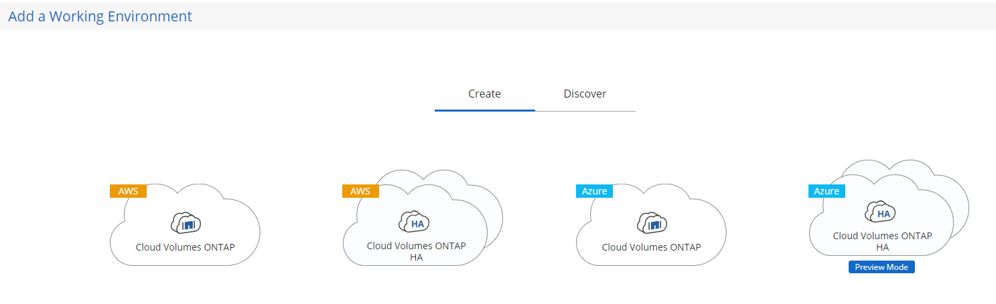
Cloud Manager
Deploy a Cloud Volumes ONTAP by using Cloud Manager from Cloud Central
Notes:
Instructor Notes
Student Notes
After the Cloud Manager setup is complete, you can create an Cloud Volumes ONTAP system or discover an existing ONTAP system. Selecting Create starts the wizard-driven process to create a new working environment. As with the storage virtual machine (SVM) setup wizard in OnCommand System Manager, you can optionally create a volume during the setup process.

Slide 21
Cloud Volumes ONTAP Software
Architecture details
The software is available as a single system or a high-availability (HA) pair.
Each Cloud Volumes ONTAP software supports a single storage virtual machine (SVM).
Cloud Manager creates this SVM when it launches an instance.
You can create another SVM from CLI or OnCommand System Manager, but the use of multiple SVMs is not supported.
Several network interfaces are created by default.
A cluster management LIF
An intercluster LIF
A node management LIF
An iSCSI data LIF
A CIFS and NFS Data LIF
Note: LIF failover is disabled by default due to Amazon Elastic Compute Cloud (Amazon EC2) requirements.
Notes:
Instructor Notes Remember to highlight that Cloud Volumes ONTAP is a single SVM only.
Student Notes

Slide 22
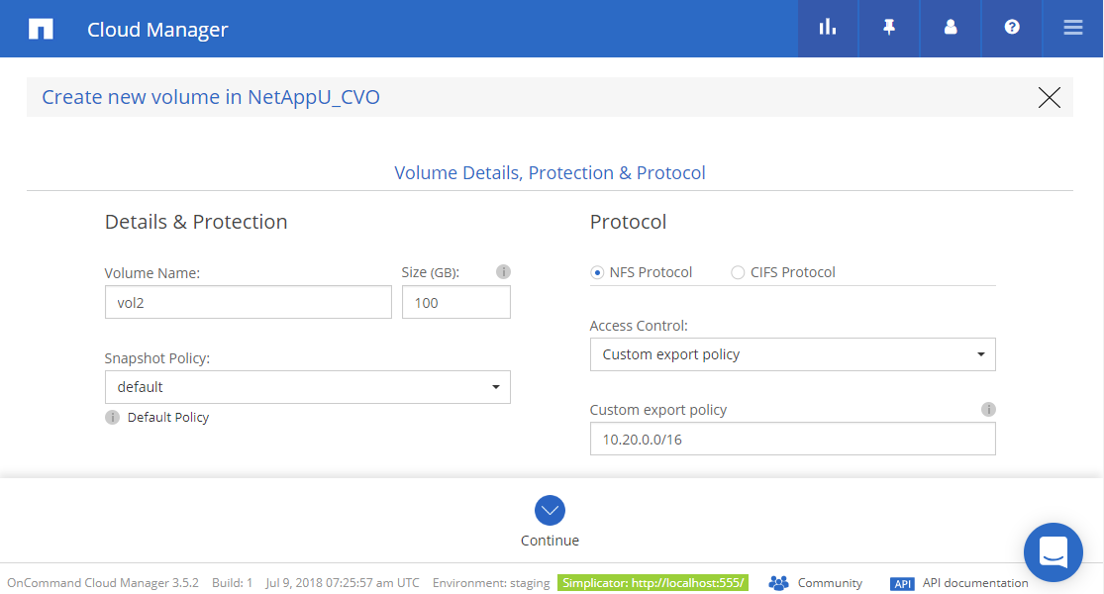
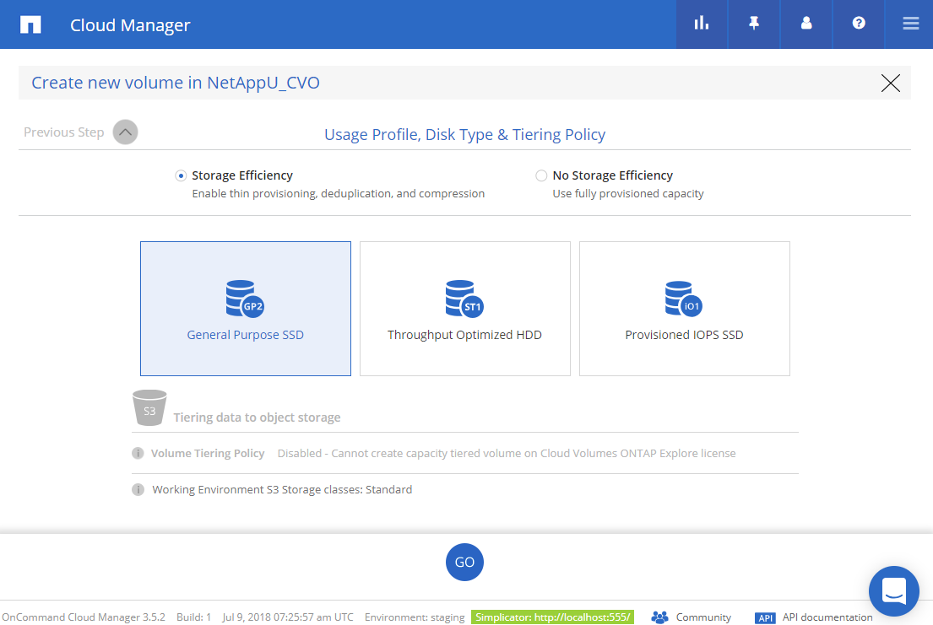
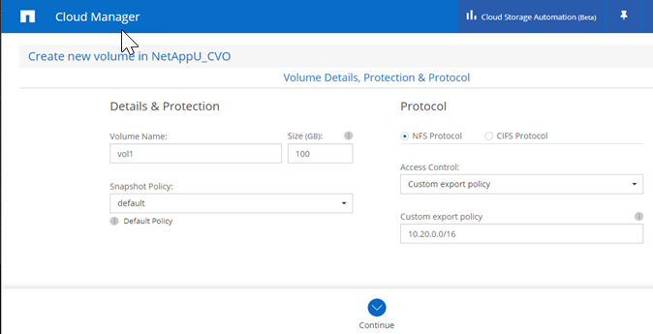
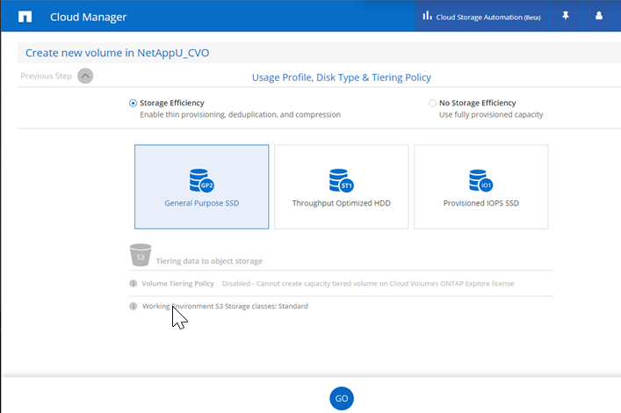
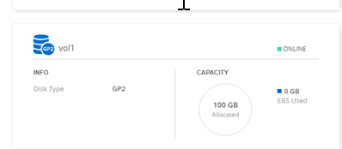
Cloud Manager
Provisioning volumes
Notes:
Instructor Notes
This is a screen shot for creating volumes in an CVO using Cloud Manager.
[1] You fill in details with the name for the volume, its size, the protocol used to access it and details such as export policy for NFS access or CIFS configuration for CIFS access. Then you click on continue.
[2] Next you need to fill out the Usage profile – choose Storage efficiency or No Storage efficiency
Disk Type: General purpose SSD, Throughput Optimized HDD or provisioned IOPS HDD.
Tiering Policy: Tiering policy on this screen shot is grayed out because the CVO was created using Explore license for which tiering is disabled. If any other license was chosen while creating the CVO, you can choose tiering policy of Auto or Snapshot only or Backup or None.
[3] The browser will take you to the Volumes Page. The info about the volume created will appear on the Volumes Page.
Student Notes
You can provision volumes from either Volume View or Storage System View. After entering the details, click Create.

Slide 23
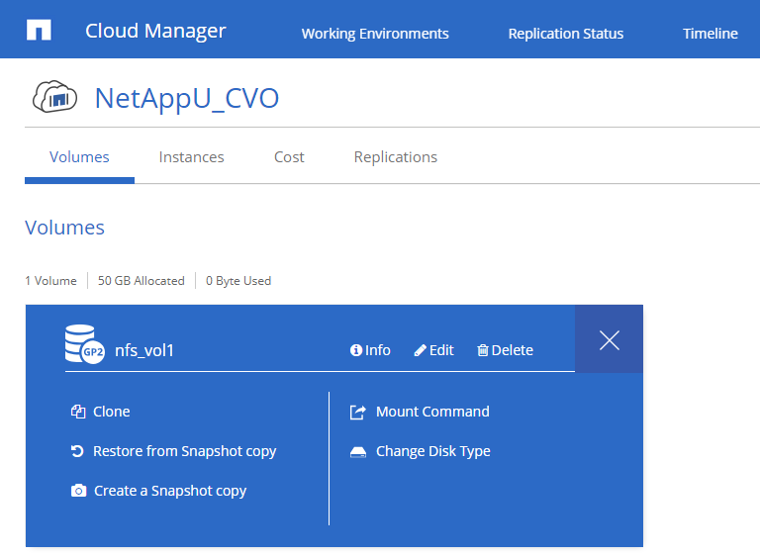
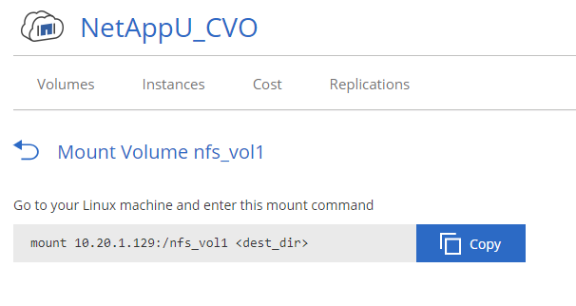
Cloud Manager
Managing volumes
Notes:
Instructor Notes
Student Notes
You manage volumes from the Volumes pane in Cloud Manager. For information about how to access the volume, click the Mount command. You can create volumes by clicking Add New Volume.

Slide 24
General Networking Requirements for Cloud Manager
Connection to target networks
Outbound internet access to deploy and manage Cloud Volumes ONTAP
Ports and security groups
Notes:
Instructor Notes
Connection to target networks
Cloud Manager requires connection to the AWS VPCs or the Azure VNets in which you want to deploy CVO.
For example, if you install Cloud Manager in your corporate network, then you must set up a VPN connection to the AWS VPC or Azure VNet in which you launch Cloud Volumes ONTAP.
Outbound internet access to manage CVO
Cloud manager will contact AWS endpoints like CloudFormation, EC2, etc. to deploy CVO in AWS.
OCCM will contact Azure endpoints like https://management.azure.com, https://login.microsoftonline.com, api.services.cloud.netapp.com:443, etc to deploy CVO in Azure.
Users access OCCM from a web browser. The machine running the web browser must have outbound access to connect to the Cloud Manager host and to the endpoints for centralized user authentication through the NetApp Cloud Central.
Proper ports and Security group rules need to be available depending on whether OCCM is deployed in AWS or Azure or in the on-premises environment.
For more info: https://docs.netapp.com/us-en/occm/reference_security_groups.html#rules-for-cloud-manager
Student Notes

Slide 25
Cloud Volumes ONTAP
General Networking Requirements
Outbound internet access for Cloud Volumes ONTAP nodes
Security groups
Connection from Cloud Volumes ONTAP to Amazon Simple Storage Service (Amazon S3 or S3) or Azure Blob Storage for data tiering
Connections to ONTAP systems in other networks
DNS and Active Directory for CIFS
For multi-AZ high-availability (HA) deployment in AWS:
3 dedicated AZs
3 floating IPs
NAS data access (1 on each node)
Cluster management
Storage virtual machine (SVM) management (optional)
Notes:
Instructor Notes
Student Notes
Cloud Volumes ONTAP nodes require outbound internet access to send messages to NetApp AutoSupport, which proactively monitors the health of your storage.
Routing and firewall policies must allow AWS HTTP and HTTPS traffic to mysupport.netapp.com.
If you have a NAT instance, you must define an inbound security group rule that allows HTTPS traffic from the private subnet to the internet.
The high-availability (HA) mediator instance must have an outbound connection to the Amazon Elastic Compute Cloud (Amazon EC2) service so that it can assist with storage failover. To provide the connection, you can add a public IP address, specify a proxy server, or use a manual option.
The manual option can be a NAT gateway or an interface Virtual Private Cloud (VPC) endpoint from the target subnet to the Amazon EC2 service.
You do not need to create security groups because Cloud Manager does that for you.
If you want to use EBS as a performance tier and Amazon S3 as a cloud tier, you must ensure that Cloud Volumes ONTAP has a connection to S3. The best way to provide that connection is by creating a VPC Endpoint to the S3 service.
When you create the VPC Endpoint, be sure to select the region, VPC, and route table that corresponds to the Cloud Volumes ONTAP instance. You must also modify the security group to add an outbound HTTPS rule that enables traffic to the S3 endpoint. Otherwise, Cloud Volumes ONTAP cannot connect to the S3 service.
More information:
https://docs.netapp.com/us-en/occm/reference_networking_aws.html
https://docs.netapp.com/us-en/occm/reference_networking_azure.html

Slide 26
Cloud Manager API
Enables automation and management of Cloud Volumes ONTAP
Can perform operations on the following:
Administrative resources
Auditing resources
Authentication resources
Working environment resources
Provides interactive API documentation through Swagger interface
You need to use authentication APIs before you use TryIt from Swagger.
API URLs are relative to ip_address:port/occm/api
API Documentation: https://docs.netapp.com/us-en/occm/api.html
Notes:
Instructor Notes
API URLs start with ipaddress:port/occm/api/ and then <resource category>/ etc…
Athentication procedures are provided in the documentation.
Swagger Interface is also available from the Cloud Manager GUI.

Slide 27
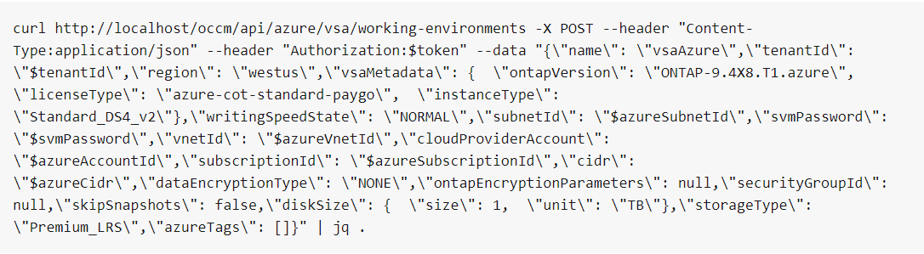
Cloud Manager API
Example
Launching a single Cloud Volumes ONTAP instance in Azure
Notes:
Instructor Notes
The above curl command comes from swagger.
The intention of this slide is to let students know that they can use the interactive Swagger tool to try out an API and get the equivalent curl command that they can use in scripting. More info can be found from the link to the API documentation page.

Slide 28


Hands-On Activity
Module 3: NetApp Cloud Volumes ONTAP
Exercise 1:
Using OnCommand Cloud Manager to Deploy Cloud Volumes ONTAP
This exercise requires approximately 90 minutes.
Notes:
Instructor Notes
Takes 25 minutes for CVO to come up after deploy starts.
Student Notes

Slide 29

AWS
N. VirginiaRegion
VPC
Primary VPC – 10.221.0.0/16
Public Subnet 10.221.16/20
On-Premises Data Center
W2k16 Amazon EC2 Instance
NATGW
IGW
Availability Zone us-east-1a
VGW
VPN Connections
Private Subnet : 10.221.0.0/20
RedHat Linux Instance
RedHat Linux Instance
Cloud Manager
Cloud Volumes ONTAP
Availability Zone us-east-1b
Notes:
Instructor Notes
The instructor can choose to use this slide here to talk about what the student will do in the labs and/or use it at the end of the module to give a summary of what they did in the lab.
They deploy Cloud Manager in the private subnet. They use Cloud Manager and create a working environment by deploying CVO in the private subnet of the VPC. Since there is a NAT GW that provides outbound internet connection from the private subnet, we have satisfied the networking requirements.
Explanation for the slide:
The students will deploy the OCCM in the private subnet .
They will then use it to deploy CVO in the private subnet.
CVO takes 25 minutes to deploy.

Slide 30

ACTION: Share Your Experiences
Roundtable questions for the exercise
How does Cloud Manager have correct permissions to provision AWS resources for Cloud Volumes ONTAP software?
How many SVMs can a Cloud Volumes ONTAP instance support?
Can you add more disks to a Cloud Volumes ONTAP aggregate by using Cloud Manager?
30
Notes:
Instructor Notes
Question 1: You set up the Cloud Provider permissions by creating a Cloud Man IAM user account and attaching a policy with correct permissions to that account. You then provided the access key for that Cloud Man IAM user when setting up Cloud Manager. When Cloud Manager makes request to AWS it does it as that IAM user with those permissions. Could ask students to look at that IAM user and the policy permissions again.
Question 2: One.
Question 3: Yes. You can add disks to the aggregate in the ONTAP Cloud SVM from within the Volume tab, Advanced > Advanced allocation.
Student Notes
If you encounter an issue, notify your instructor immediately so that it can be resolved promptly.

Slide 31
What Next?
Now that you have Cloud Manager and Cloud Volumes ONTAP software installed, what can you do with them?
Notes:
Instructor Notes
Student Notes

Slide 32

Module Review
You use Cloud Manager to deploy Cloud Volumes ONTAP in AWS or Azure.
Cloud Volumes ONTAP is a software version of ONTAP for the cloud with all its rich features.
Cloud Volumes ONTAP can be used to manage data that can be accessed by using NFS, CIFS, or iSCSI protocols.
Cloud Manager is a management tool for managing Cloud Volumes ONTAP in the cloud and on-premises.
You can perform some high-level management functions from Cloud Manager, but for more fine-grained control, you use OnCommand System Manager.
Notes:
Instructor Notes The use of System Manager for the CVO is covered in the labs.
Student Notes

